Slide 1

AAIDM: Data Science 1: Introduction to Datascience
Bram Heijligers & Nitin Bhushan

Slide 2

Introduction Lecturers
Bram Heijligers
PhD-candidate [title], 2020 - Ungoing; Tilburg University
MSc Cognitive Science and Artificial Intelligence, 2018 - 2020; Tilburg University
BSA International Game Architecture and Design – Design and Production, 2012 - 2018; Breda University of Applied Sciences
Neuro-cognitive research into learning and game experience
Game Design and Project management
(Mixed-Reality) Educational Games
Managing Covid-19 Contract Tracing Operations

Slide 3
Introduction Lecturers
Nitin Bhushan
Qualifications?
Portfolio and work experience

Slide 4
What is data science?
Somebody who solves problems & questions using data and various statiscical analyses in a computirized environment.
Bla bla

Slide 5
What is data?
Example 1
Example 2

Slide 6
How do we describe an object?
Large
Long
Old

Slide 7
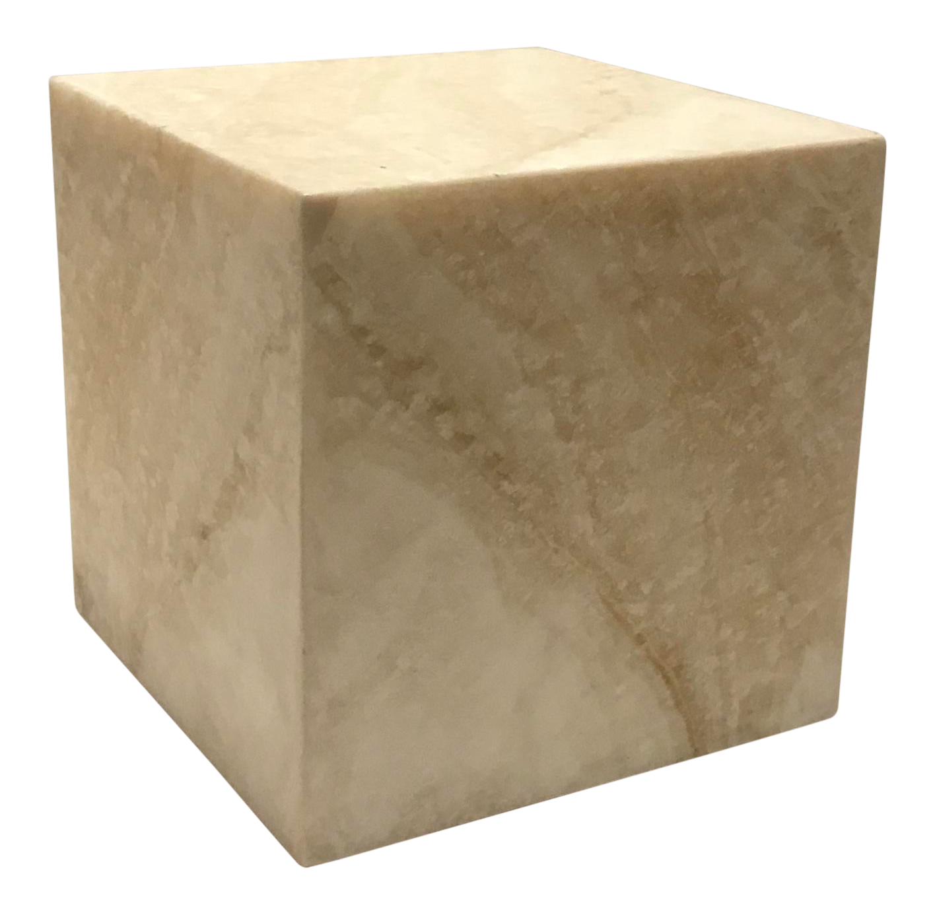
Objects quantified to data
Variables:
var1
Notes:
Mass
Weight
Height
Age
Orientation
Position

Slide 8
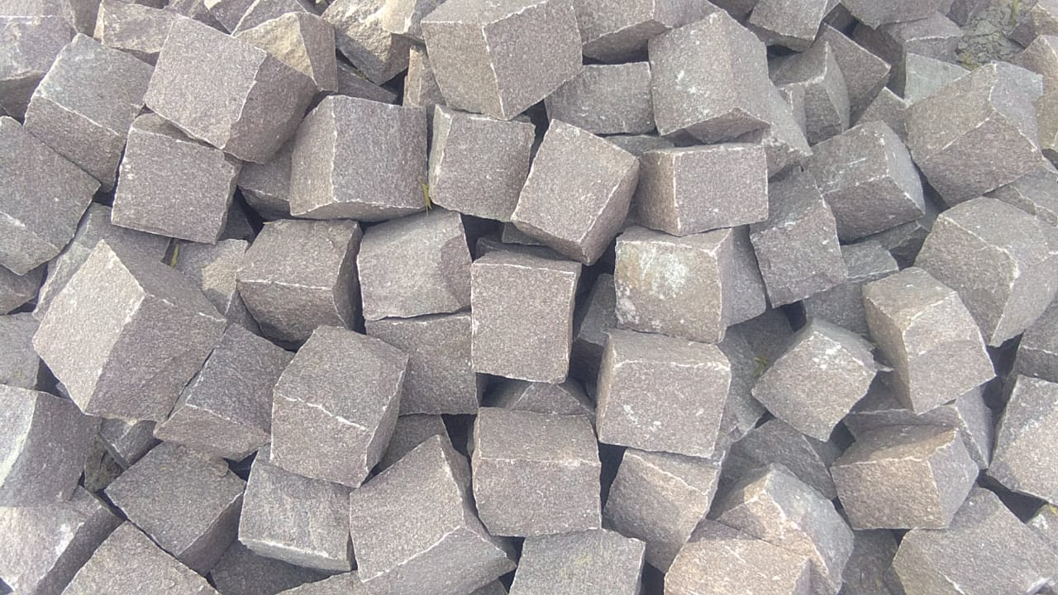
Objects quantified to data
Variables:
var1
Notes:
Mass
Weight
Height
Age
Orientation
Position

Slide 9
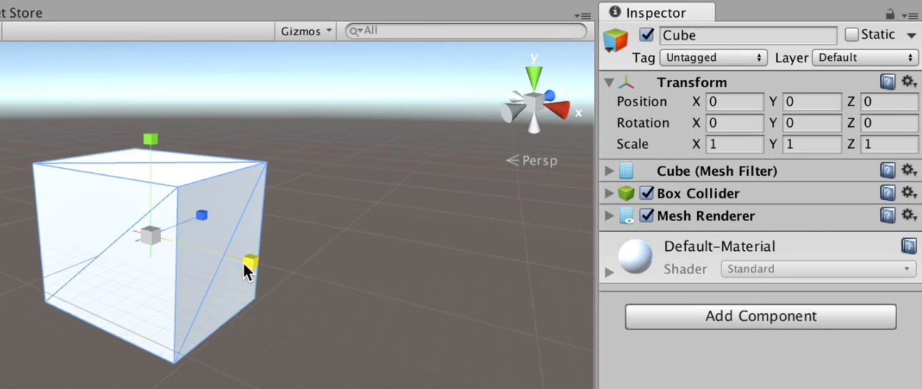
Objects quantified to data
Variables:
var1
Notes:
Mass
Weight
Height
Age
Orientation
Position

Slide 10

Objects quantified to data
Variables:
var1
Notes:
Mass
Weight
Height
Age
Orientation
Position

Slide 11

You in data; QS
Example 1
Example 2

Slide 12
You in data; QS
[keep track of some data as a student; coffee drank a day]

Slide 13

How do we describe phenomena?
Example 1
Example 2

Slide 14
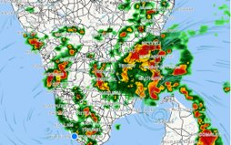
Phenomena quantified
Weather things
Covid-19 spread
Social network analysis

Slide 15
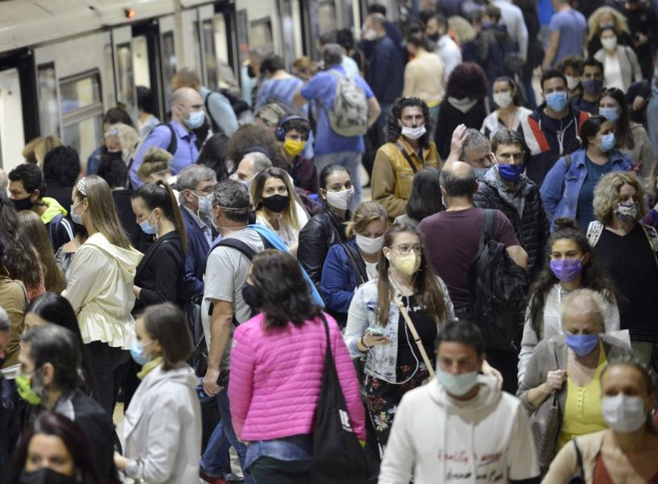
How do we describe phenomena?
text

Slide 16
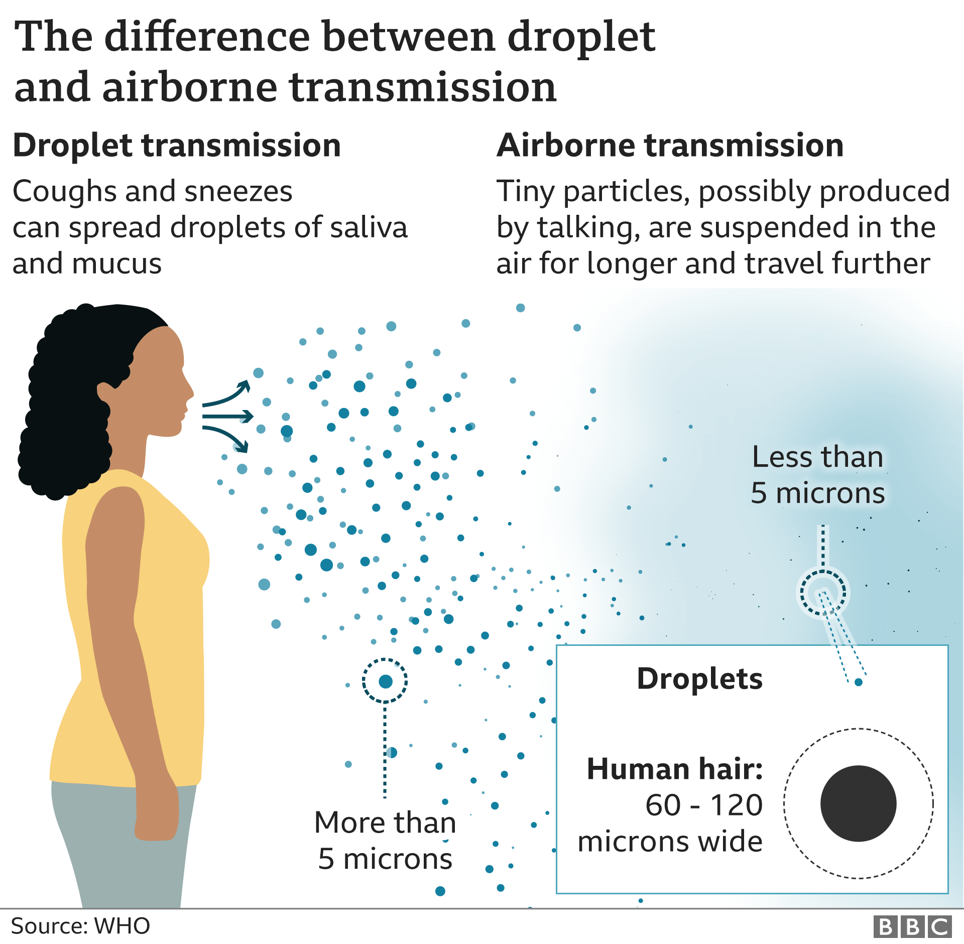
Phenomena quantified
Weather things
Covid-19 spread
Social network analysis

Slide 17
Phenomena quantified
https://gisanddata.maps.arcgis.com/apps/opsdashboard/index.html#/bda7594740fd40299423467b48e9ecf6
https://www.cdc.gov/coronavirus/2019-ncov/covid-data/forecasting-us.html

Slide 18
Bram in data; QS
You can also capture social and behavioural phenomena which emerge by the interaction of individuals with one another and environment:

Slide 19
How do we store and process data?
We’ll get into that next lecture
Now let’s look at the course approach and structure
Then we’ll have some hands-on work

Slide 20
Statistical Software
What we’re gonna use and why

Slide 21
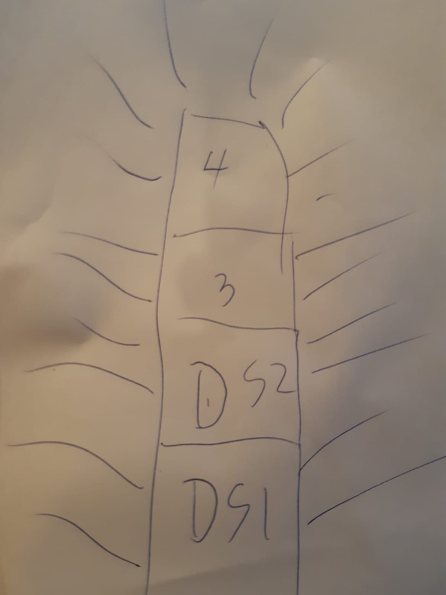
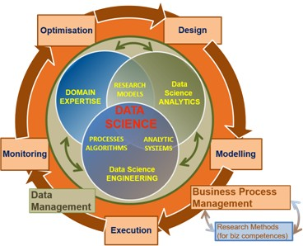
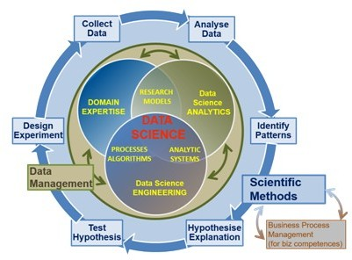
Educational Approach
Things
Notes:
Maybe too complex for block a, year 1

Slide 22
Course Approach
3 days a week where every course day is structured as follow:
Video-lecture for presenting and discussing the main concepts, using practical examples: 30 – 1 hours
Structured self-study at home or in Data Lab: 3 - 6
Working on assessment building-blocks at home or in Data Lab: 1 – 4 Hours

Slide 23
Course Content
Introduction to Data Science(codifying the world in data, attributes)
Variables (data frames, continuous, nominal, ordinal etc.)
Descriptive analyses (mean, sd, range, IQR) & visualisation (boxplots)
Introduction to Probability (random variable, distributions)
Introduction to statistical inference (sample, population, hypothesis testing)
Analysing Relationships between variables (e.g., compute correlation by hand)
Reporting & visualising (Academic Skills)
Introduction to regression & machine learning(supervised, unsupervised, the CRISP DM model)
Conference Poster Creation
You are here

Slide 24
Assesment
Create a Conference Poster based on case studies and examples introduced online and in-class; the focus is on all stages of the data science process (formulating the problem; selecting the data and exploratory data analyses technique(s); interpretation of descriptive data; reporting and visualizing the data) from an elementary level. Propose next steps: an analysis to run on the data.
Building blocks for the final poster are created at the end of each workshop day, they can be handed till the end of the day for feedback before assesment. Building blocks handed in after 9:00 are no-longer accepted.
[Link to assessment rubric]
Notes:
So there's only one assement: the datalab one.

Slide 25
Practical details
[Time & dates]

Slide 26
Any questions?
Ask me on Microsoft Teams, I reply during working hours.
You can also e-mail me at: Heijligers.b@buas.nl

Slide 27
1) Get R
In order to run swirl, you must have R 3.1.0 or later installed on your computer.
If you need to install R, you can do so here.
For help installing R, check out one of the following videos (courtesy of Roger Peng at Johns Hopkins Biostatistics):
Installing R on Windows
Installing R on Mac

Slide 28
2) Get RStudio
In addition to R, it’s highly recommended that you install RStudio, which will make your experience with R much more enjoyable.
If you need to install RStudio, you can do so here. Select the appropriate installer for your operating system.

Slide 29
3) Install swirl
Open RStudio (or just plain R if you don't have RStudio) and type the following into the console:
> install.packages("swirl")
Note that the > symbol at the beginning of the line is R's prompt for you type something into the console. We include it here so you know that this command is to be typed into the console and not elsewhere. The part you type begins after >.

Slide 30
4) Start swirl
This is the only step that you will repeat every time you want to run swirl. First, you will load the package using the library() function. Then you will call the function that starts the magic! Type the following, pressing Enter after each line:
> library("swirl")
> swirl()

Slide 31
5) Install the DS1-course
The first time you start swirl, you'll be prompted to install a course. You can either install one of the recommended courses or visit the course repository for more options. There are even more courses available from the Swirl Course Network.
We’re going to install a course which is not part of the repository
To install a course that is not part of our course repository, type ?InstallCourses at the R prompt for a list of functions that will help you do so.
[procedure to install in the DS1-course]

Slide 32
6) Do the workshop exercises
[procedure to open in the DS1-course]
Content:
Tutorial: A introduction to swirl by the swirl software
Tutorial: An introduction to R-studio by the course material
Source: http://swirlstats.com/scn/A_(very)_short_introduction_to_R.html
MVP: let them do this one; if more time: chop in sections to deliver the information when they need it: JIT
Questions: Defining objects as data
Source: Bram
Questions: Defining phenomena as data
Source: Bram

Slide 33
7) Create the assesment building blocks
5 Questions:
Choose an object or phenomena (form list: HYPERLINK) you want to investigate
Describe the object formally
Quantify the object/phenomena into variables
Form a data-driven research question
Describe the background for your research question
Notes:
Look at the

